Slide 1
Presentation on “GIT”
Name:Pujasree Saha
ID:141014024

Slide 2
What is GIT?
GIT is a version control system for tracking changes in computer files and coordinating work on those files among multiple people.
GIT started in 2005.
Created by Linus Torvald to aid in Linux Kernel Development.
GitHub is a web-based Git or version control repository and Internet hosting service.

Slide 3
Basic Terms of GIT:
Commit
Clone
Push
Pull
Status
Add
Reset
branch

Slide 4
GIT Repositories
Project can live in a remote server
There are many solution for posting repositories
Such as
Bitbucket
Github
gitmeat
gitlab

Slide 5
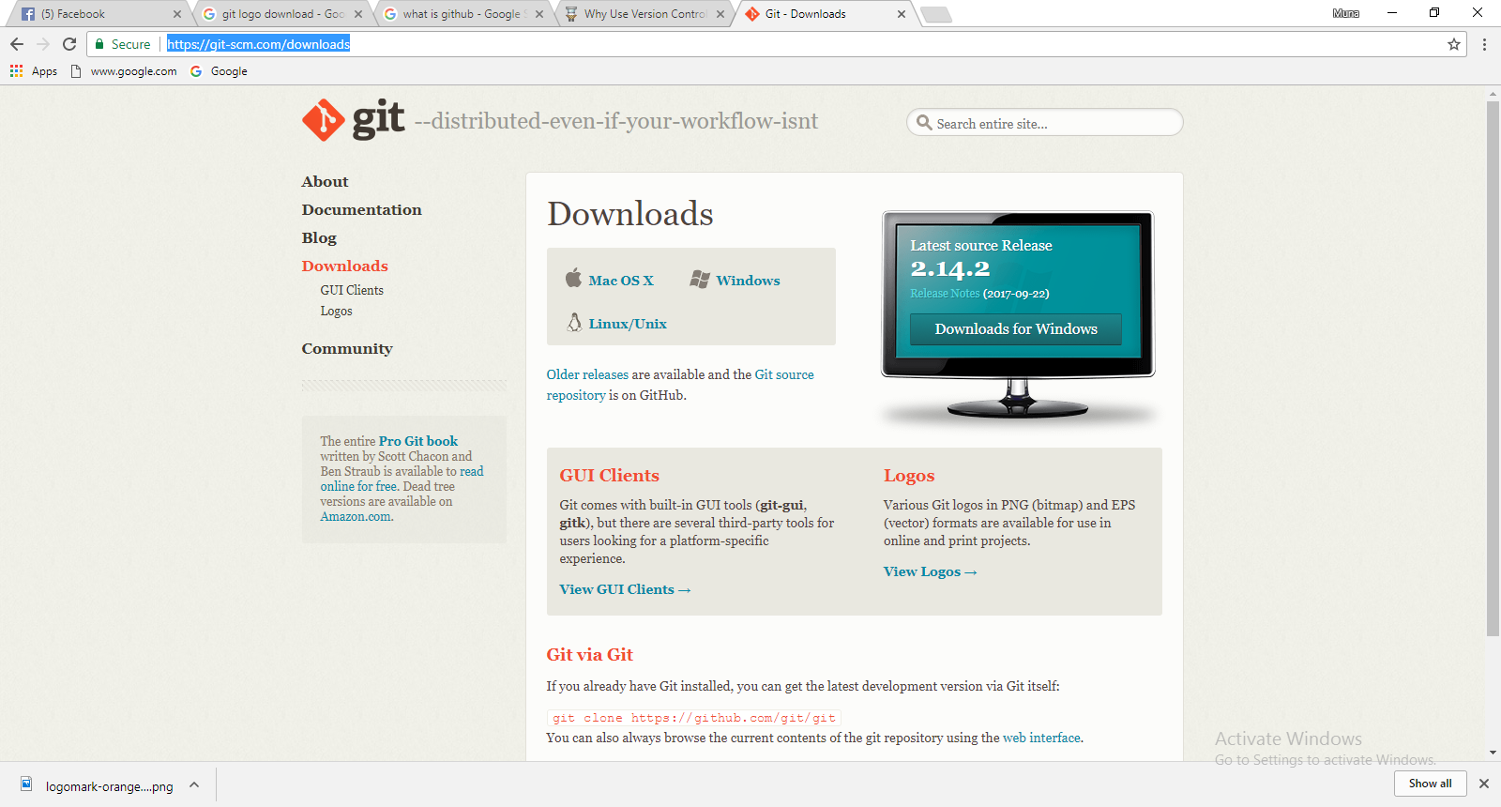
Installation
Open any browser .
Go to this link “https://git-scm.com/downloads”

Slide 6
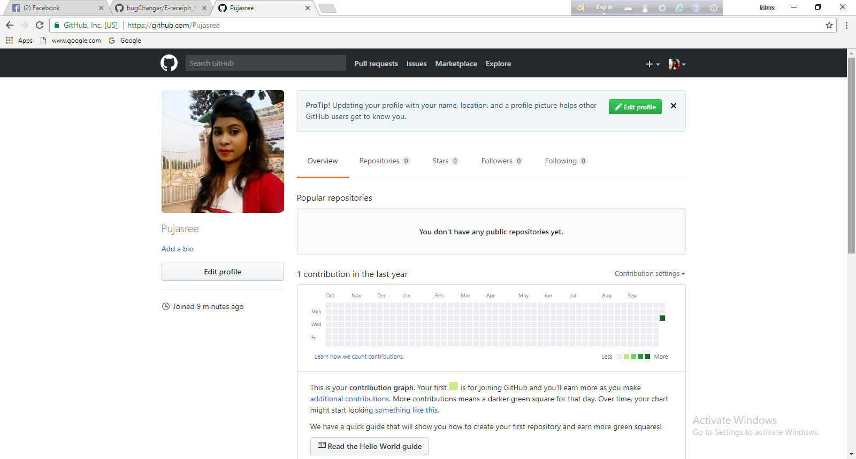
Github Account

Slide 7
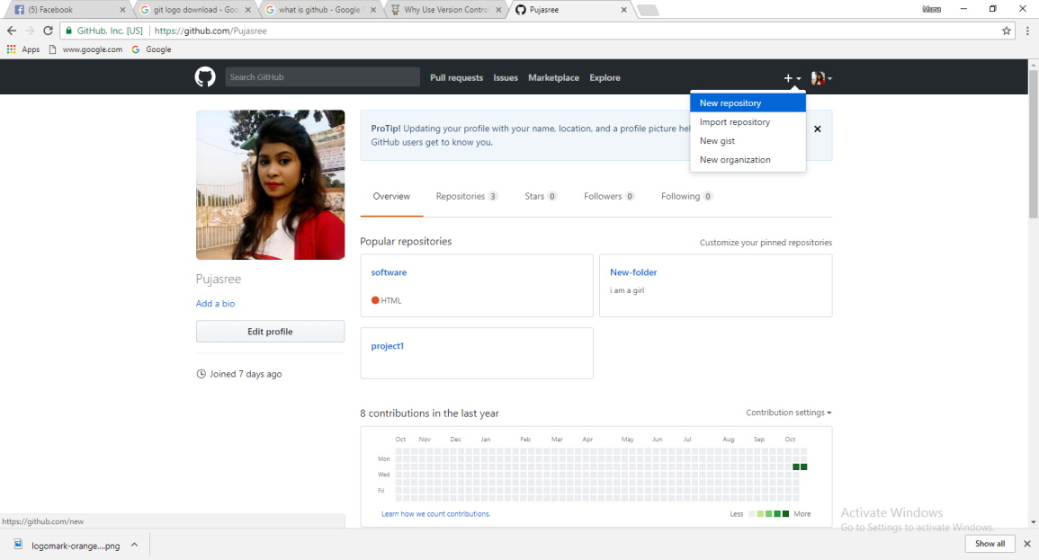
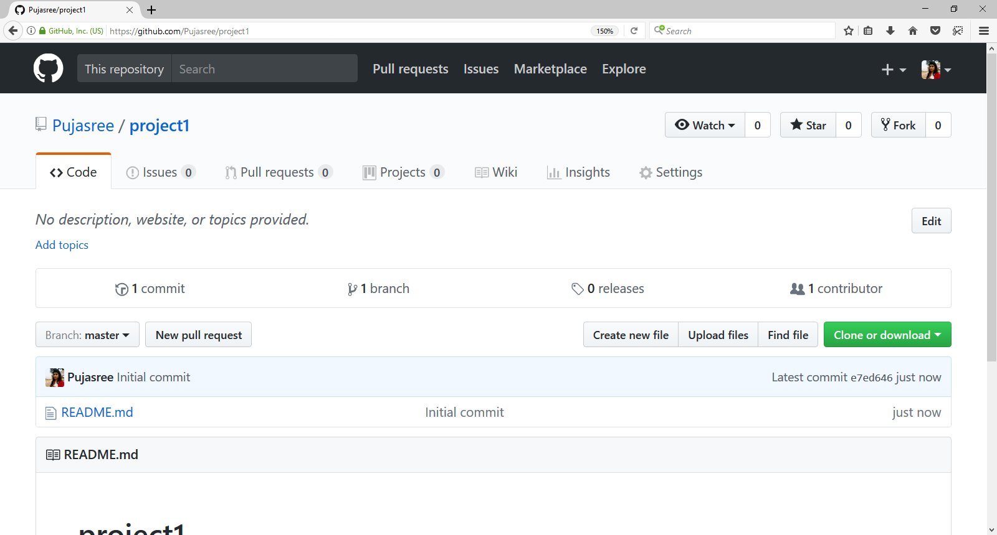
Create Repository

Slide 8
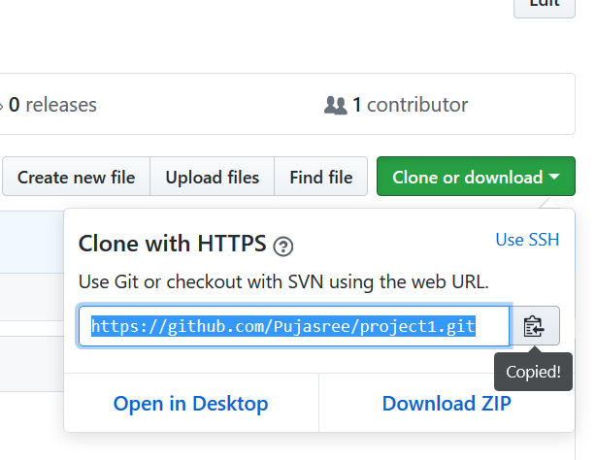
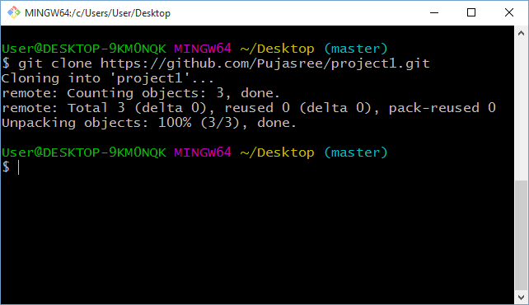
Clone

Slide 9
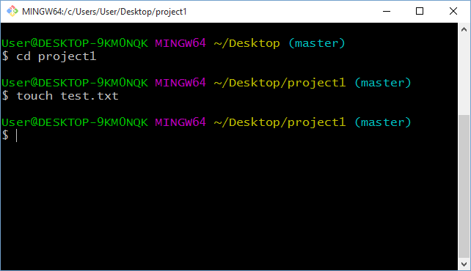
Create a new file:

Slide 10
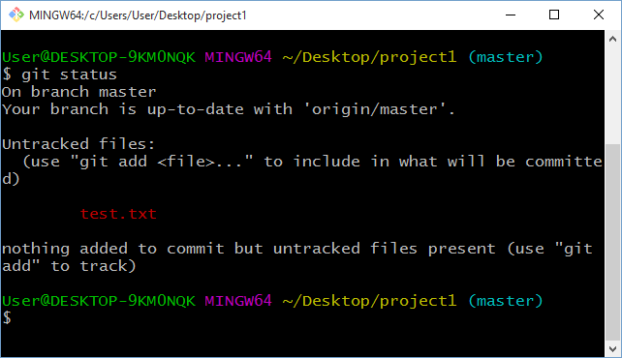
Check Status:

Slide 11
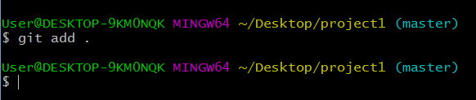
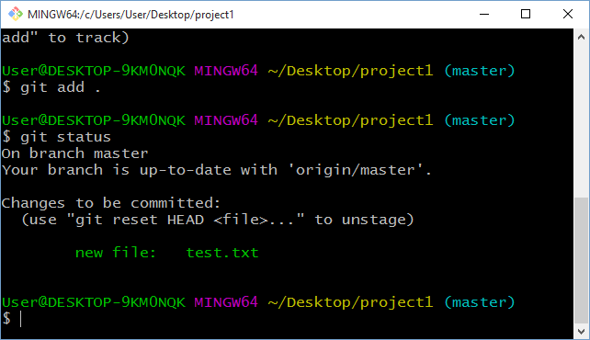
Add:

Slide 12
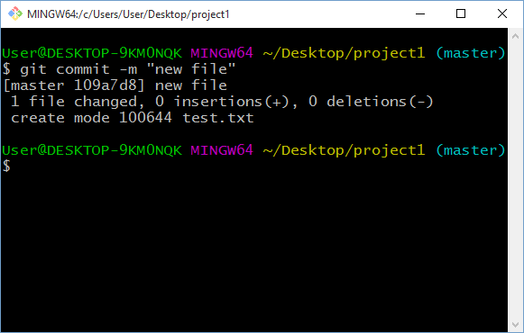
Commit
Which works we do locally,we can register those works by Commit.

Slide 13
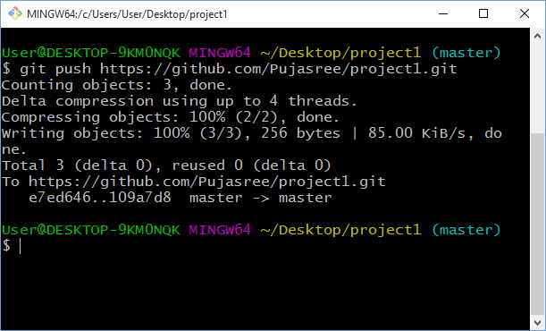
Push:

Slide 14
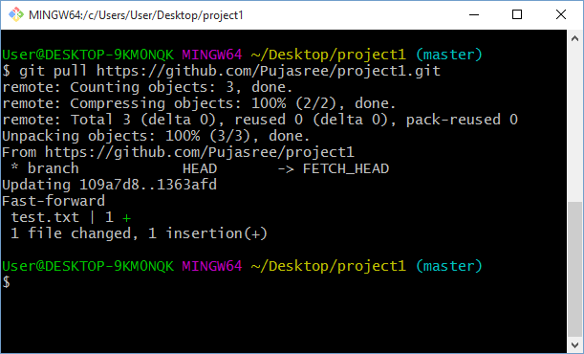
Pull:
A git pull is what you would do to bring a local branch up-to-date with its remote version, while also updating your other remote-tracking branches.

Slide 15


